Slide 1
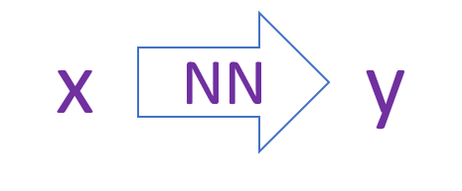
Learning strategy | Input data
x
NN
y
Regression
Supervised
(x, y)
Classification
TSEN
Un-supervised
(x)
x
NN
x
Auto-encoder

